Slide 1
Interactive Naruto Map

Slide 2
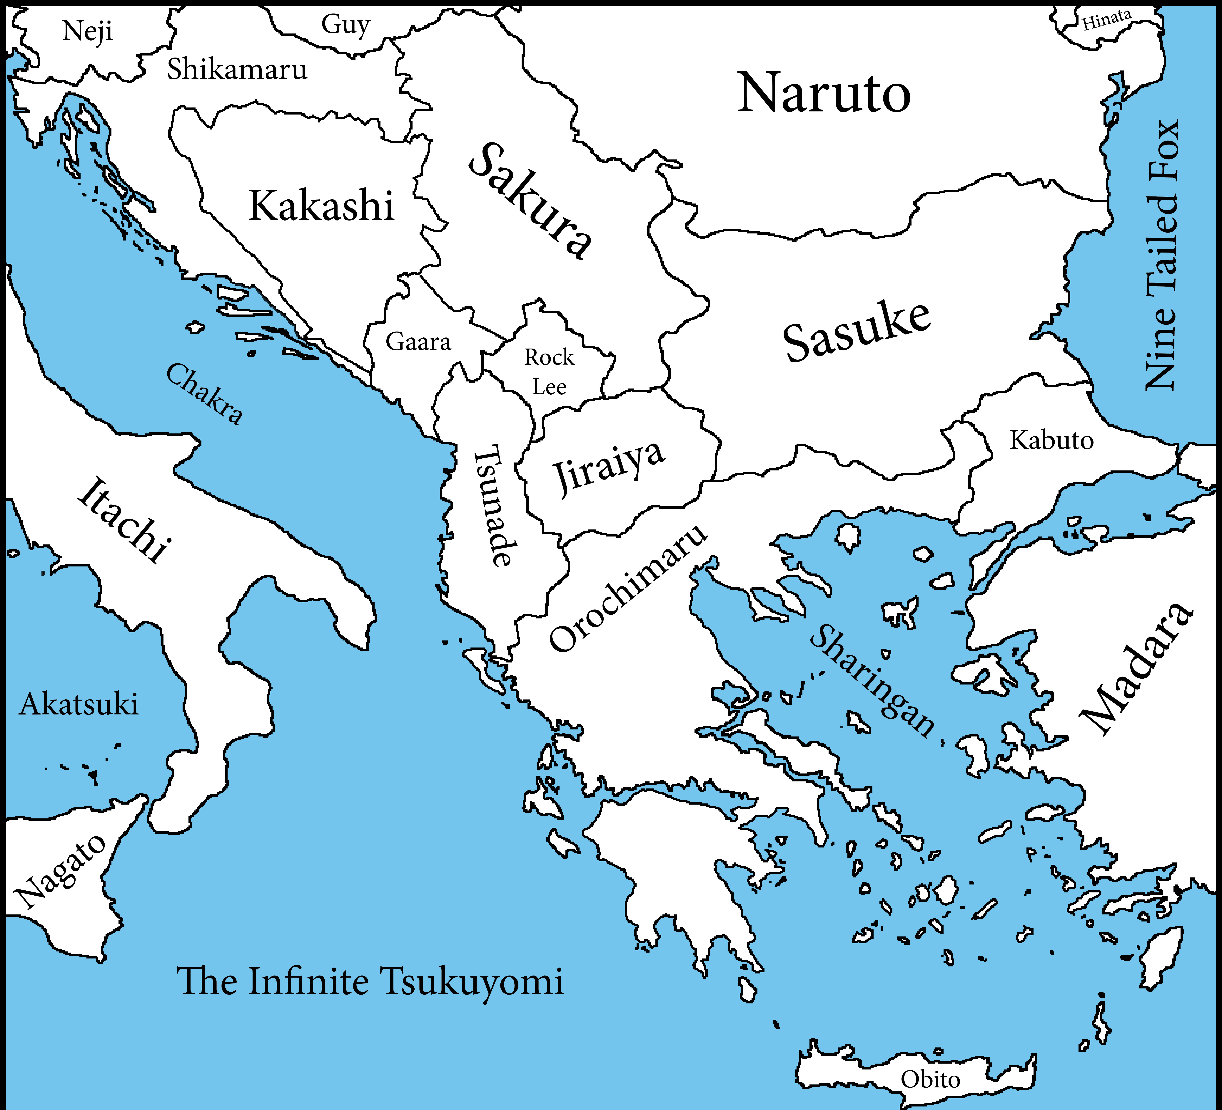
First Project
To build upon my first project, I have created an interactive map. I have created clickable links to each character which takes you to a page with the characters descriptions. I have kept the same general concept of the first project and expanded more on it. I also used a map generator to create a made up land mass.

Slide 3
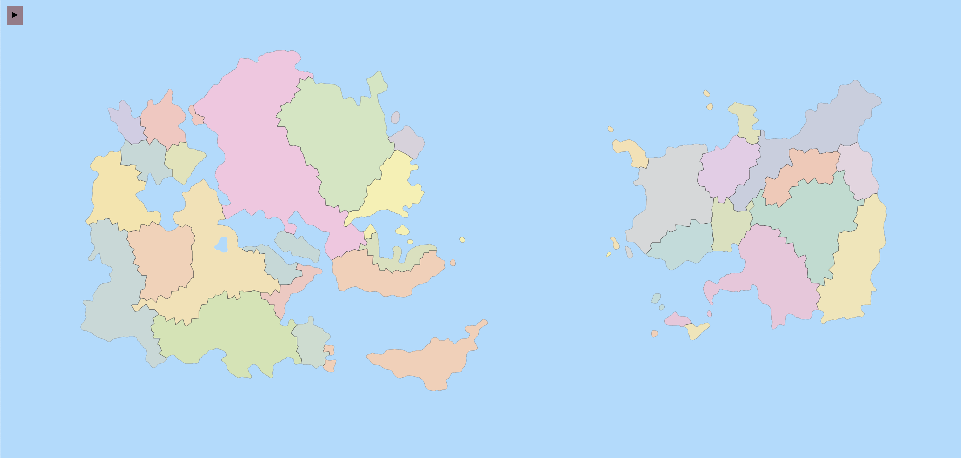
Kakashi
Deidara
Guy
Pain
Sasuke
Gaara
Tobi
Tenten
Neji
Naruto
Kabuto
Sasori
Rock
Lee
Hidan
Sakura
Madara
Kakuzu
Danzo
Ausma
Hinata
Tsunade
Zetsu
Kaguya
Itachi
Shisui
Kisame
Jiraiya
Orochimaru
Shikamaru
Jugo
Nagato
Karin
Konan
Obito

Slide 4
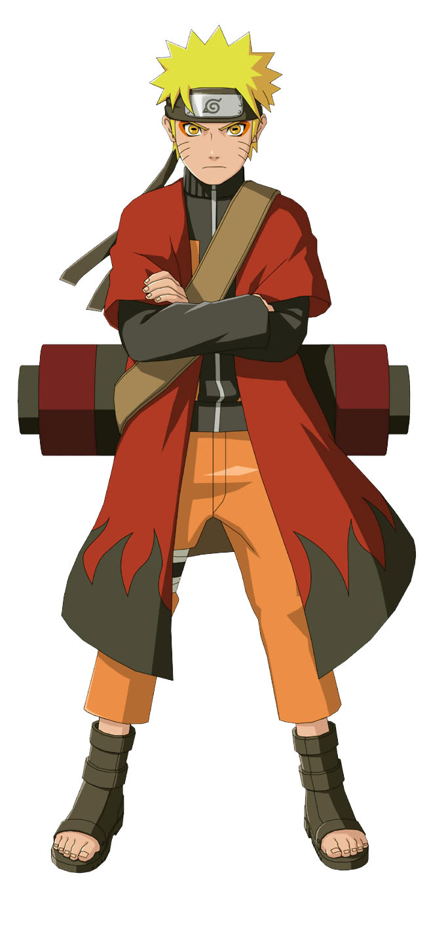
Naruto
a shinobi of Konohagahure’s Uzumaki clan. He became the jinchuriki of the Nine-Tails on the day of his birth — a fate that caused him to be shunned by most of Konoha throughout his childhood.
Back to Map

Slide 5
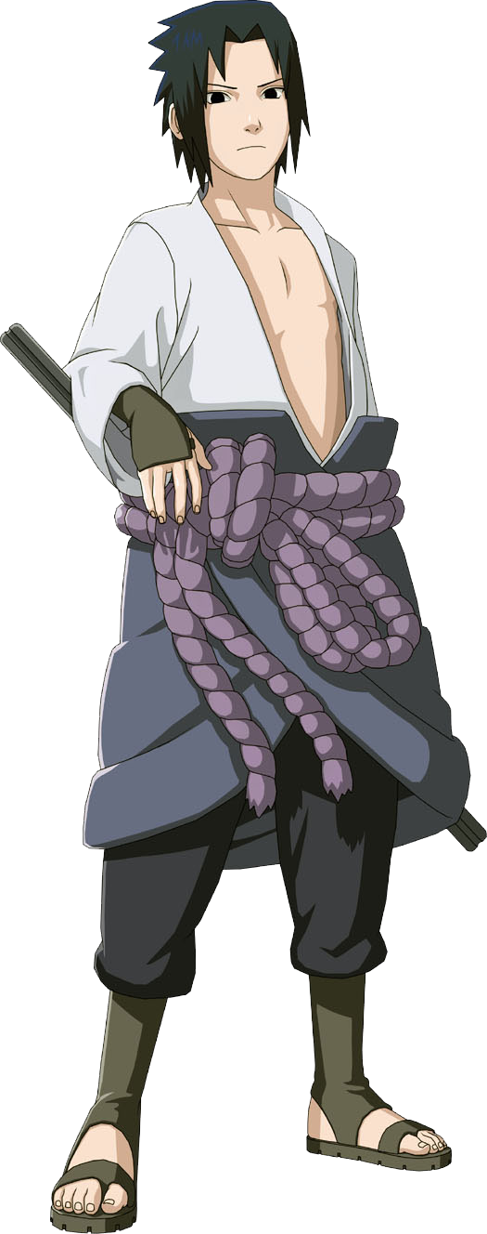
Sasuke
One of the last surviving members of Konohagakure's Uchiha clan. After his older brother, Itachi, slaughtered their clan, Sasuke made it his mission in life to avenge them by killing Itachi.
Back to Map

Slide 6
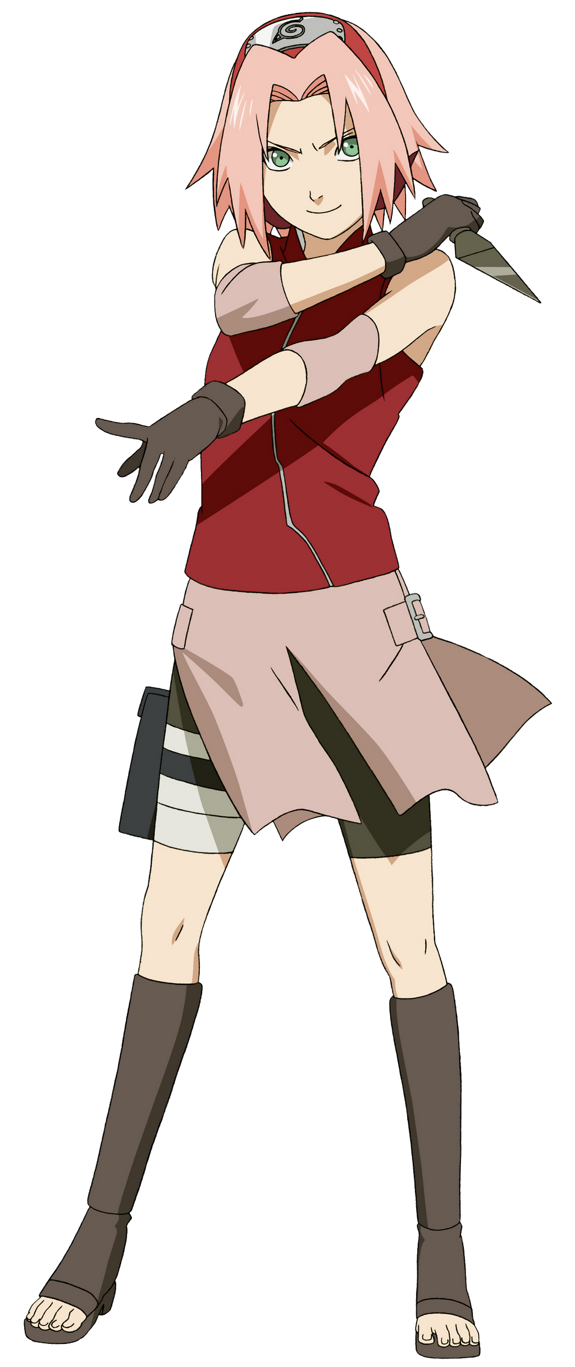
Sakura
A kunoichi of Konohagakure. When assigned to Team 7, Sakura quickly finds herself ill-prepared for the duties of a shinobi. However, after training under the Sannin Tsunade, she overcomes this, and becomes recognised as one of the greatest medical-nin in the world.
Back to Map

Slide 7
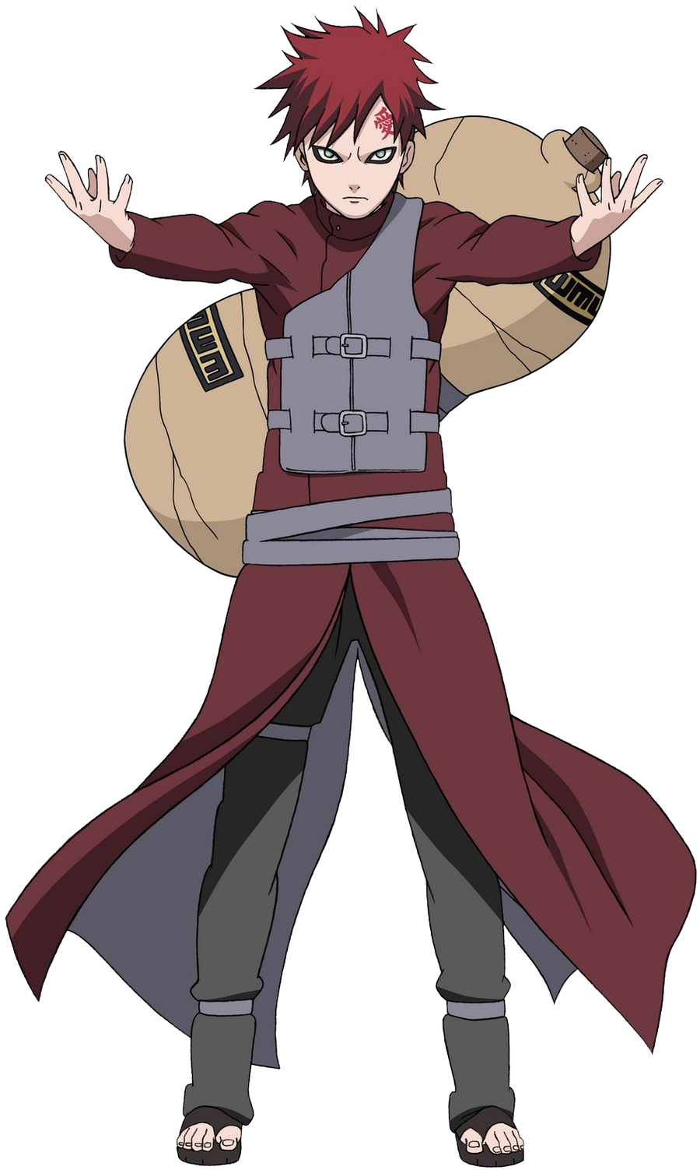
Gaara
A shinobi of Sunagakure. He was made the jinchūriki of the One-Tailed Shukaku before he was born, causing the villagers of Suna to fear him as a monster. With nobody to connect to, Gaara grew up hating the world and looking out only for himself, giving his life meaning by killing anyone he came across.
Back to Map

Slide 8
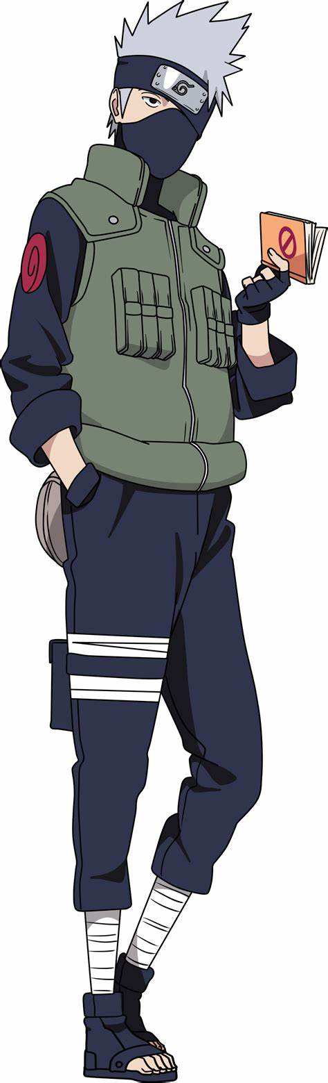
Kakashi
A shinobi of Konohagakure's Hatake clan. Famed as Kakashi of the Sharingan, he is one of Konoha's most talented ninja; regularly looked to for advice and leadership despite his personal dislike of responsibility.
Back to Map

Slide 9
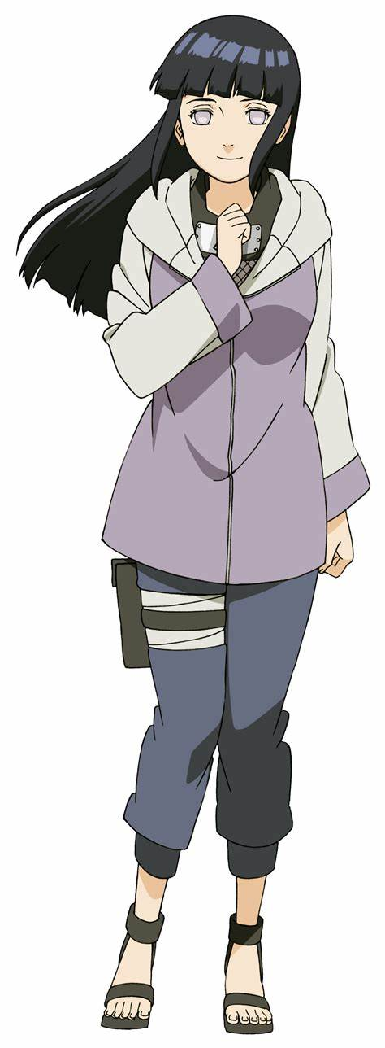
Hinata
A kunoichi of Konohagakure. Formerly the heiress of the Hyūga clan, she lost the position upon being deemed unsuited for the responsibilities of leading the clan.
Back to Map

Slide 10
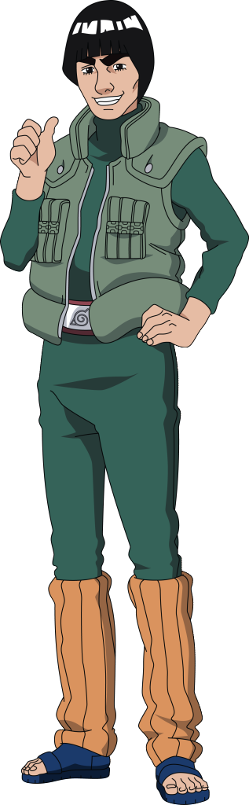
Guy
The son of Might Duy, who was known throughout Konoha as the "Eternal Genin".
Back to Map

Slide 11
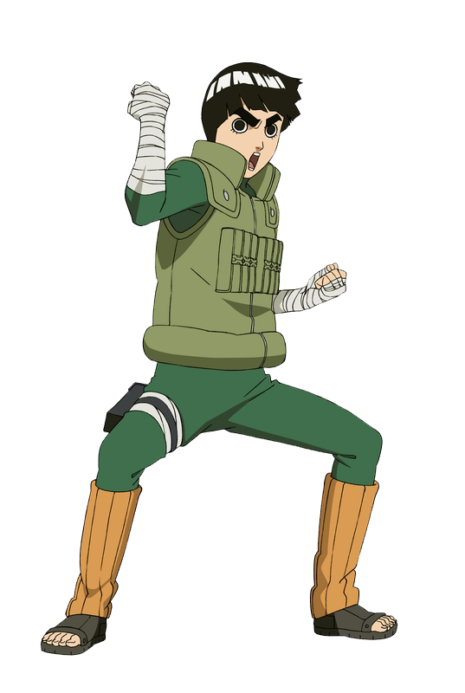
Rock Lee
A shinobi of Konohagakure's Lee clan and a member of Team Guy. Unlike most shinobi, he lacked the skills necessary to use ninjutsu or genjutsu. However, he overcomes those shortcomings by undergoing special training from Might Guy that would make him a taijutsu master while still a genin.
Back to Map

Slide 12
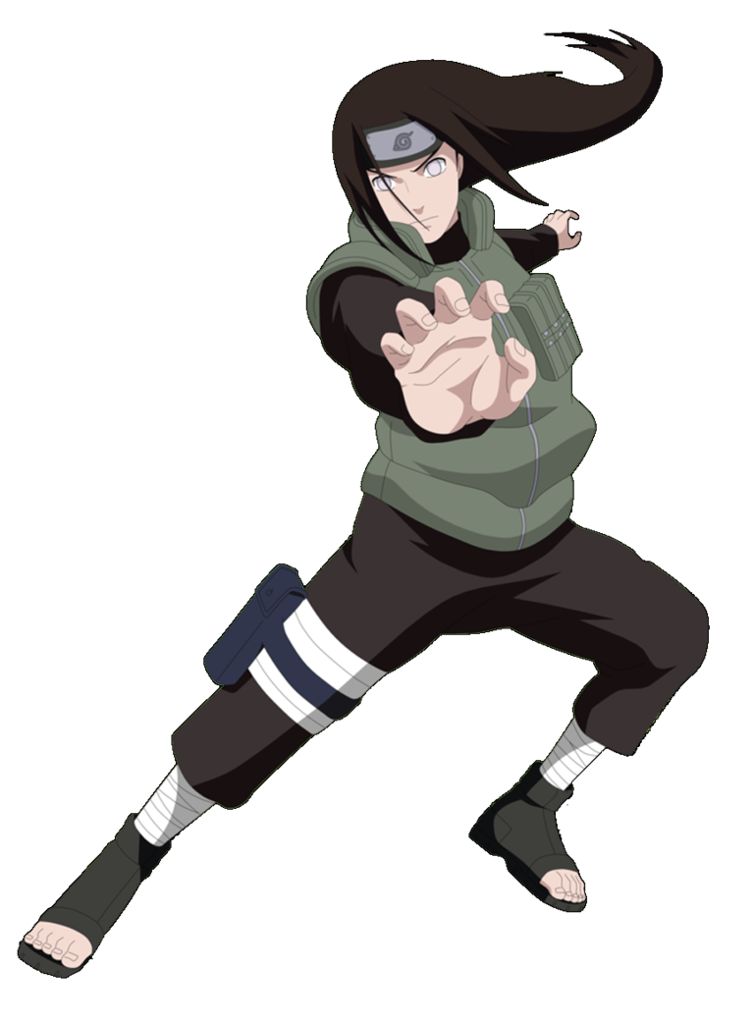
Neji
A shinobi of Konohagakure's Hyūga clan. Though a prodigy even by the Hyūga's standards, Neji was a member of the clan's branch house; no matter how skilled he became, he would always be in service to the Hyūga's main house, a fact that convinced him fate was predetermined.
Back to Map

Slide 13
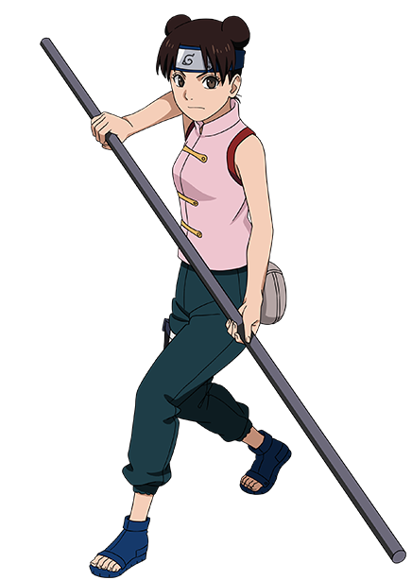
Tenten
A kunoichi from Konohagakure and a member of Team Guy. While initially wanting to be like the legendary Sannin Tsunade, she realised that she did not have the necessary chakra control to be a medical-nin. However, she did not give up on being a powerful kunoichi, putting her all into perfecting her weaponry and fūinjutsu skills.
Back to Map

Slide 14
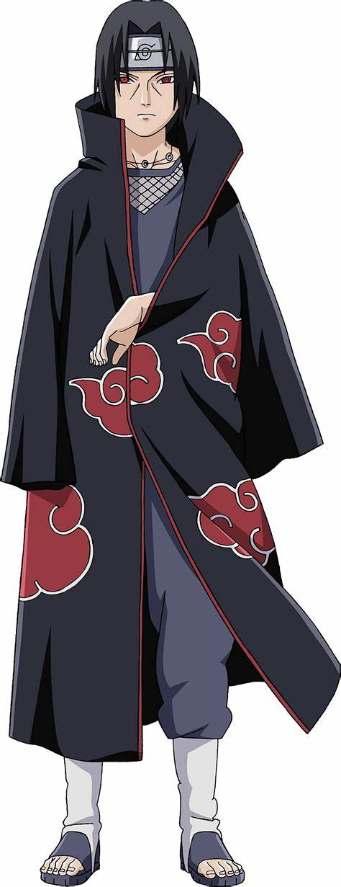
Itachi
A shinobi of Konohagakure's Uchiha clan that served as an Anbu Captain. He later became an international criminal after murdering his entire clan, sparing only his younger brother, Sasuke. He afterwards joined the international criminal organisation known as Akatsuki, whose activity brought him into frequent conflict with Konoha and its ninja.
Back to Map

Slide 15
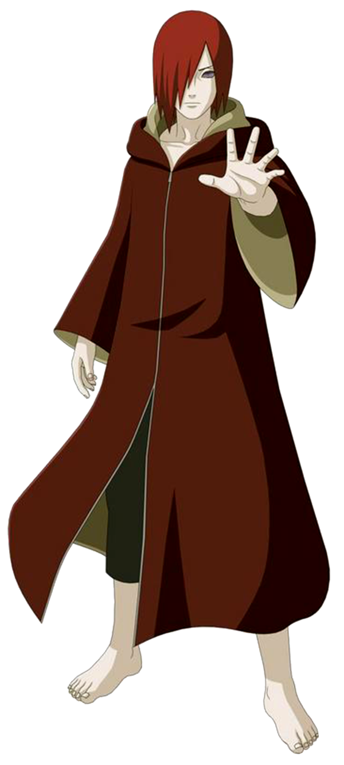
Nagato
A shinobi of Amegakure and descendant of the Uzumaki clan. Forming Akatsuki alongside his friends (and fellow war orphans) Yahiko and Konan, Nagato dreamed of bringing peace to the violent shinobi world. However, following Yahiko's death, Nagato adopted the alias of Pain and, along with Konan, began leading a new Akatsuki — one that would force the world into peace using any means necessary.
Back to Map

Slide 16
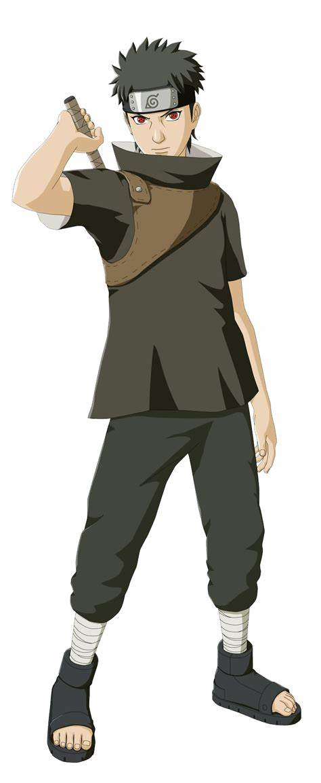
Shisui
Renowned as "Shisui of the Body Flicker" was an Anbu from Konohagakure's Uchiha clan. Graduating from the Academy during the Third Shinobi World War, Shisui was placed on a genin team alongside his best friend. Immediately after the war ended a year later, Shisui witnessed his friend die on a mission, consequently awakening the Mangekyō Sharingan.
Back to Map

Slide 17
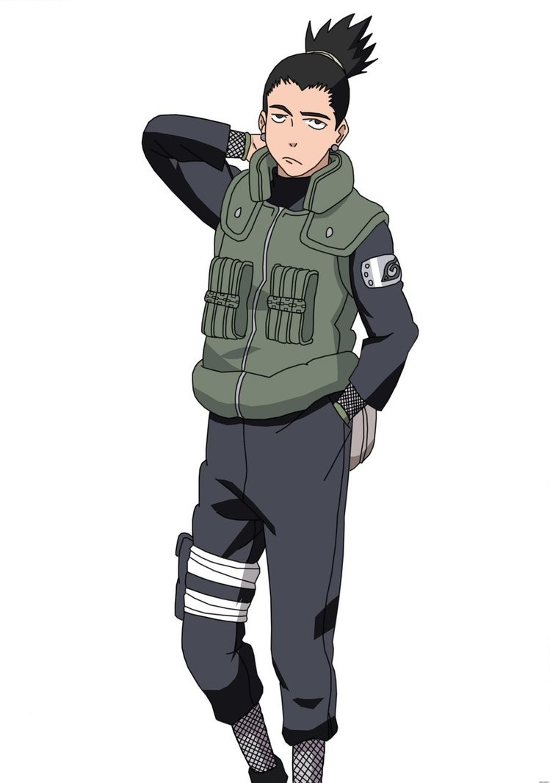
Shikamaru
A shinobi of Konohagakure's Nara clan. Though lazy by nature, Shikamaru has a rare intellect that consistently allows him to prevail in combat.
Back to Map

Slide 18
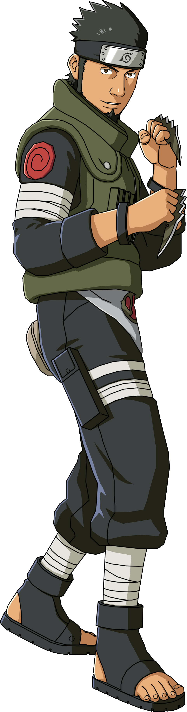
Asuma
A jōnin of Konohagakure's Sarutobi clan and a former member of the Twelve Guardian Ninja. He was also the leader of Team 10 which consists of Shikamaru Nara, Ino Yamanaka, and Chōji Akimichi.
Back to Map

Slide 19
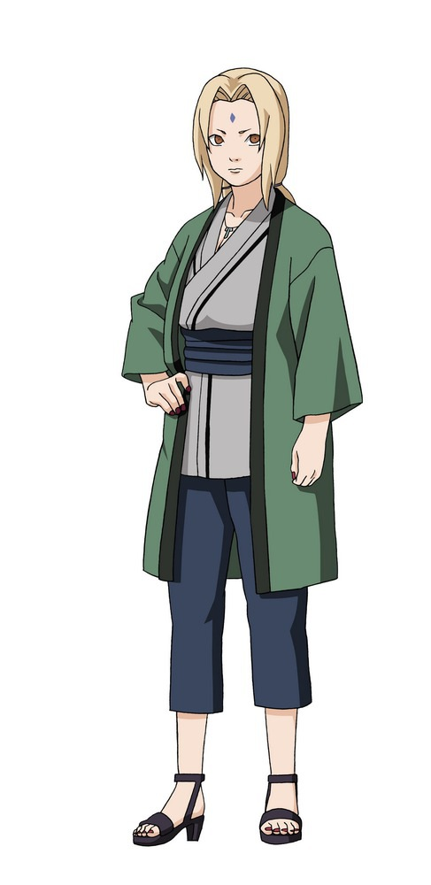
Tsunade
A descendant of the Senju and Uzumaki Clan, and is one of Konohagakure's Sannin. She is famed as the world's strongest kunoichi and its greatest medical-nin. The repeated loss of her loved ones caused Tsunade to later abandon the life of a shinobi for many years. She is eventually persuaded to return to Konoha and take on the mantle of Fifth Hokage.
Back to Map

Slide 20
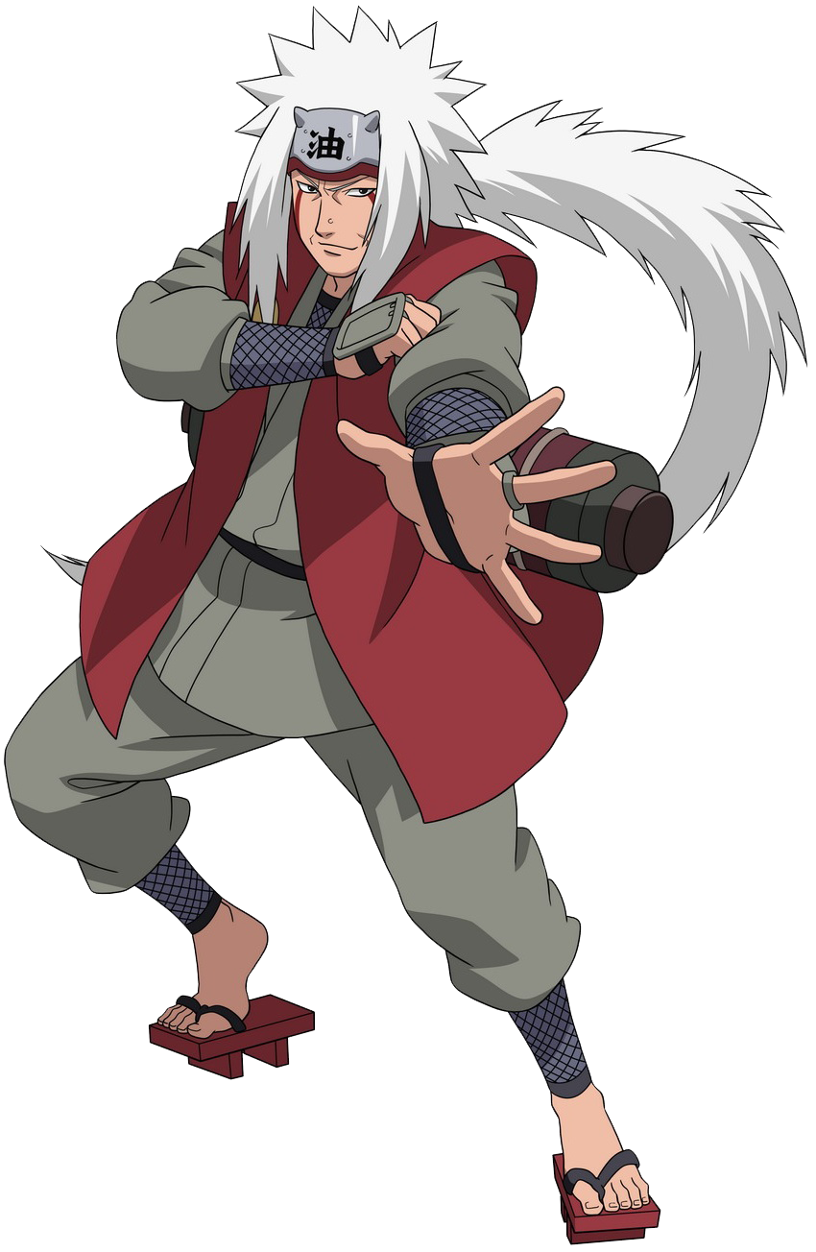
Jiraiya
One of Konohagakure's Sannin. Famed as a hermit and pervert of stupendous ninja skill, Jiraiya travelled the world in search of knowledge that would help his friends, the various novels he wrote, and, posthumously, the world in its entirety – knowledge that would be passed on to his godson and final student, Naruto Uzumaki.
Back to Map

Slide 21
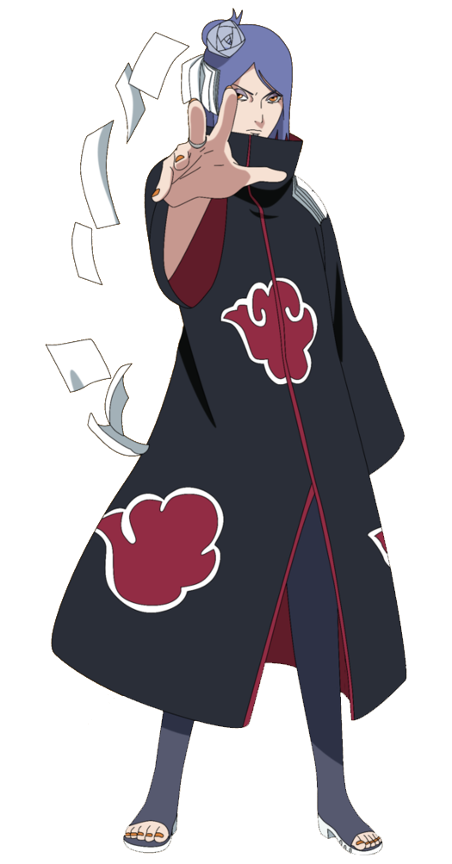
Konan
A kunoichi from Amegakure and a founding member of the original Akatsuki. After Yahiko's death, she was partnered with Nagato, who had since taken control of Akatsuki, and was the only member to call him by his name. After Nagato's death, Konan defected from Akatsuki and became the de facto village head of Amegakure.
Back to Map

Slide 22
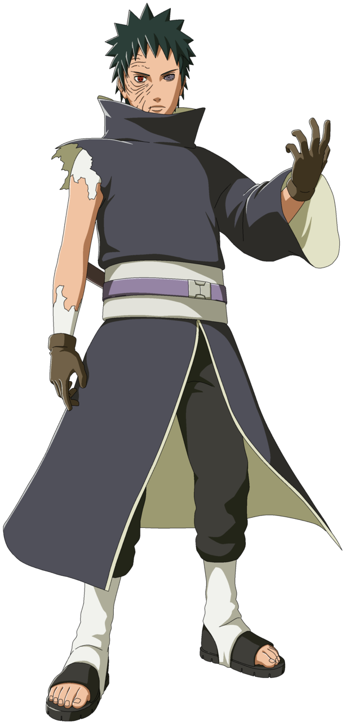
Obito
Was a member of Konohagakure's Uchiha clan. He was believed to have died during the Third Shinobi World War, his only surviving legacy being the Sharingan he gave to his teammate, Kakashi Hatake. In truth, Obito was saved from death and trained by Madara Uchiha, but the events of the war left Obito disillusioned with reality, and he inherited Madara's plan to create an ideal world.
Back to Map

Slide 23
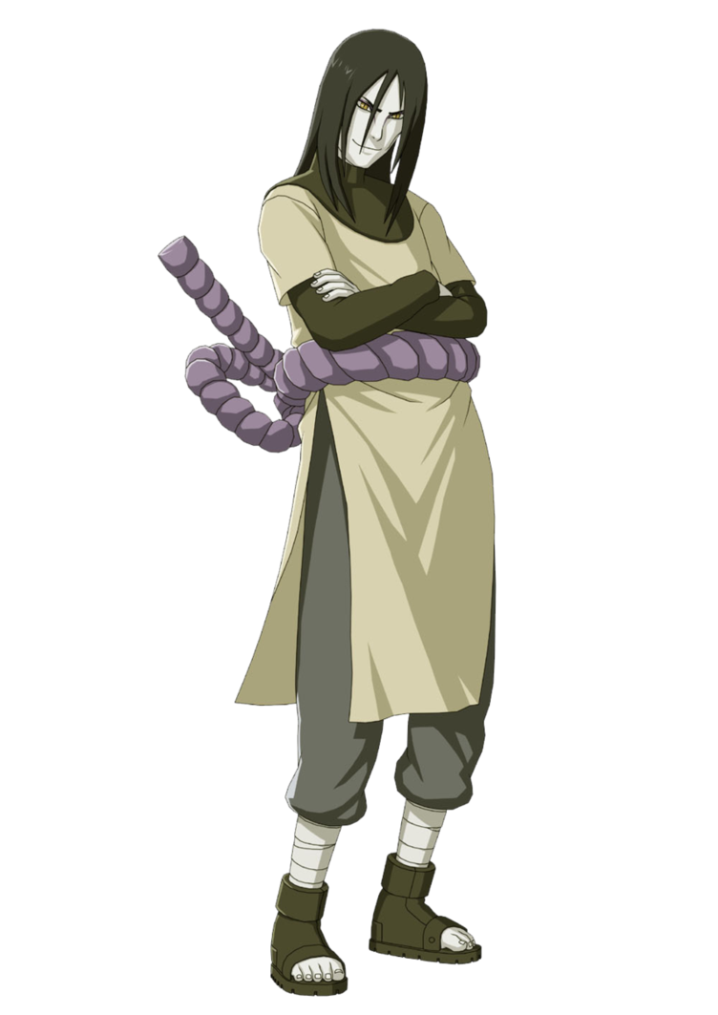
Orochimaru
One of Konohagakure's legendary Sannin. With a life-ambition to learn all of the world's secrets, Orochimaru seeks immortality so that he might live all of the lives necessary to accomplish his task. After being caught red-handed performing unethical experiments on his fellow citizens for the sake of this immortality, Orochimaru defected from Konoha rather than be persecuted for his ambitions, and for many years sought the village's destruction in order to take revenge and demonstrate what he had learned.
Back to Map

Slide 24
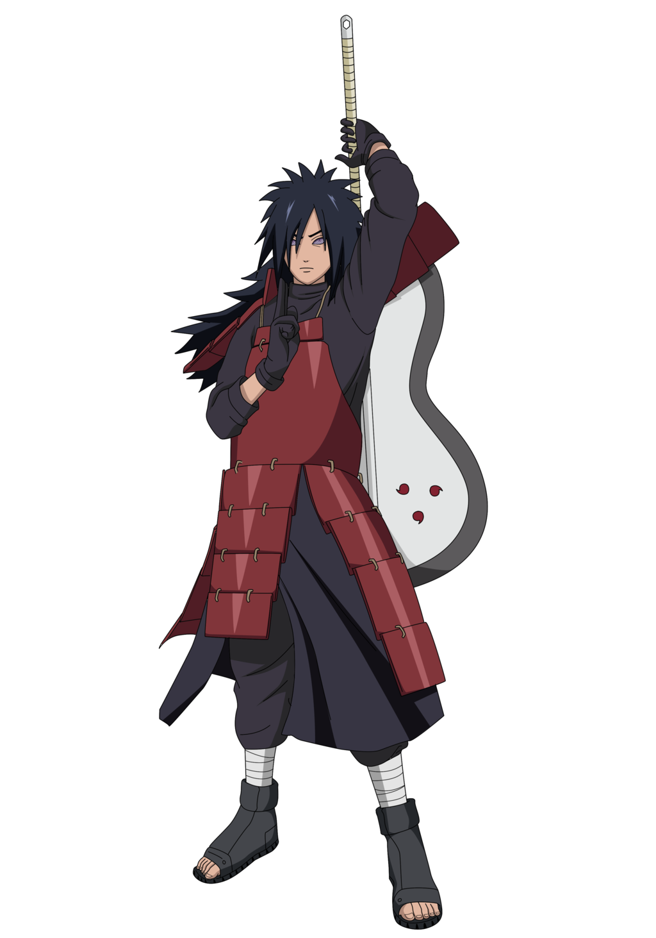
Madara
The legendary leader of the Uchiha clan. He founded Konohagakure alongside his childhood friend and rival, Hashirama Senju, with the intention of beginning an era of peace. When the two couldn't agree on how to achieve that peace, they fought for control of the village, a conflict which ended in Madara's death. Madara, however, rewrote his death and went into hiding to work on his own plans.
Back to Map

Slide 25
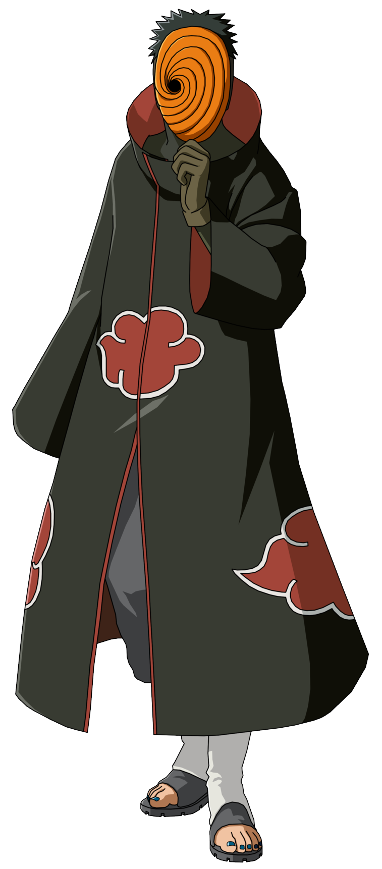
Tobi
One of the first victims of the Infinite Tsukuyomi, and eventually was pulled from the Demonic Statue of the Outer Path by Black Zetsu.
Back to Map

Slide 26
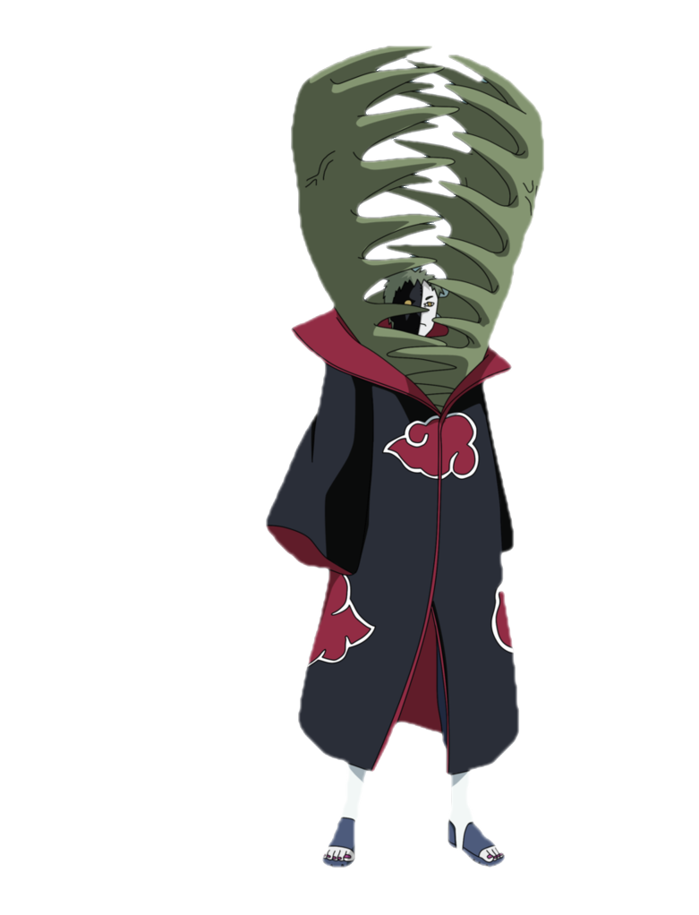
Zetsu
Pulled from the Demonic Statue of the Outer Path by Black Zetsu, and infused with the DNA of Hashirama Senju by Madara Uchiha.
Back to Map

Slide 27
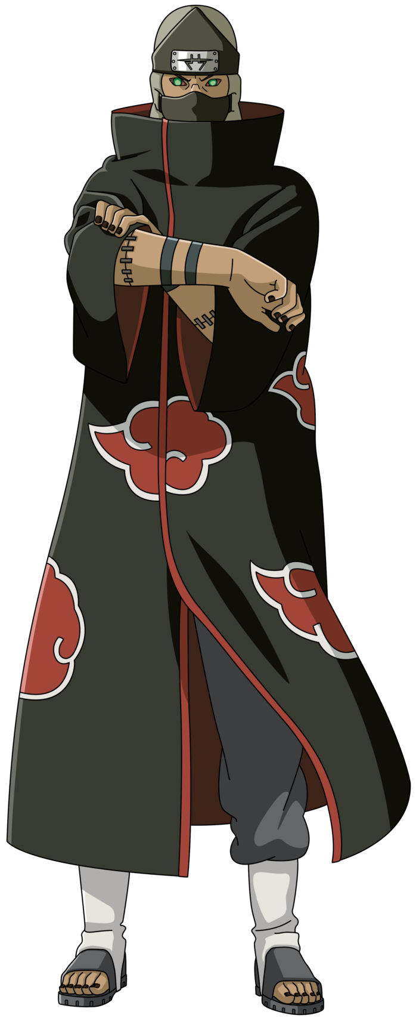
Kakuzu
An S-rank missing-nin from Takigakure and a member of Akatsuki who was partnered with Hidan. Kisame Hoshigaki jokingly referred to them as the Zombie Combo due to the fact that, in differing senses, they could not die.
Back to Map

Slide 28
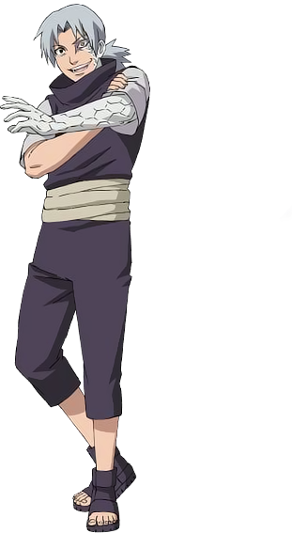
Kabuto
Spent most of his life as a spy working for many different individuals, organizations, and countries during his life. His natural talents in intelligence-gathering and medicine attracted the attention of Orochimaru when he was younger, who made Kabuto his right-hand man.
Back to Map

Slide 29
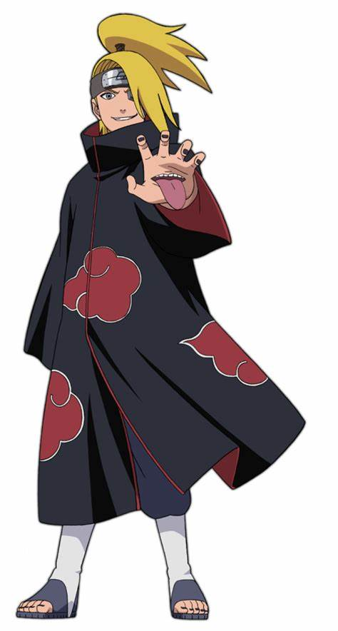
Deidara
An S-rank missing-nin from Iwagakure. During his time in the village, he was a member of the Explosion Corps. After defecting from the village, he was forced into Akatsuki and was its youngest member. There, Deidara was partnered with Sasori until the latter's death, and later with Tobi before his own death.
Back to Map

Slide 30
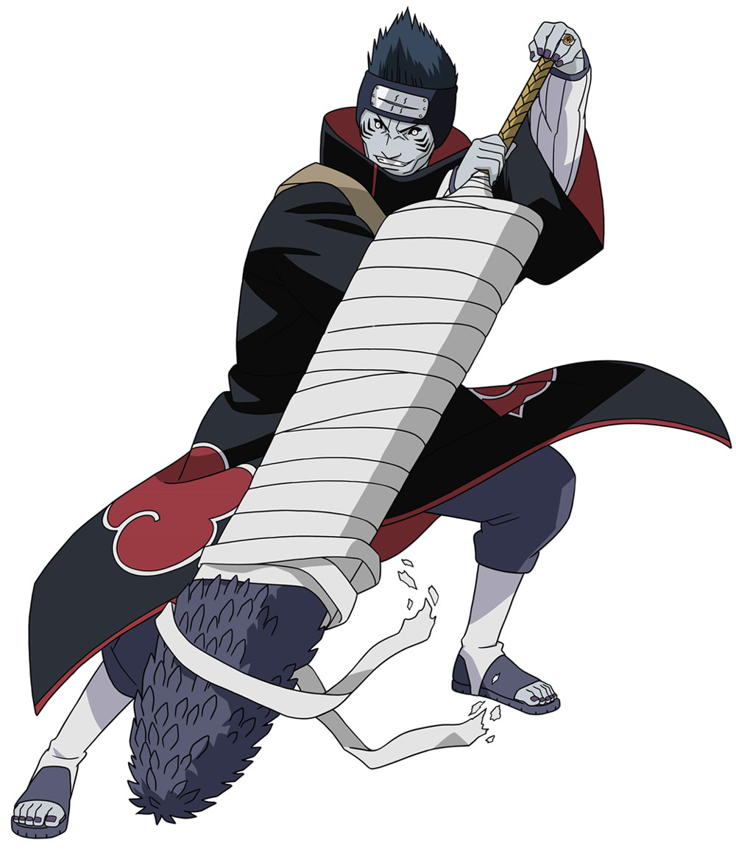
Kisame
Feared as the Monster of the Hidden Mist, was a shinobi of Kirigakure's Hoshigaki Clan. After joining the Seven Ninja Swordsmen of the Mist, he became a S-rank missing-nin and was partnered with Itachi Uchiha when the latter joined Akatsuki.
Back to Map

Slide 31
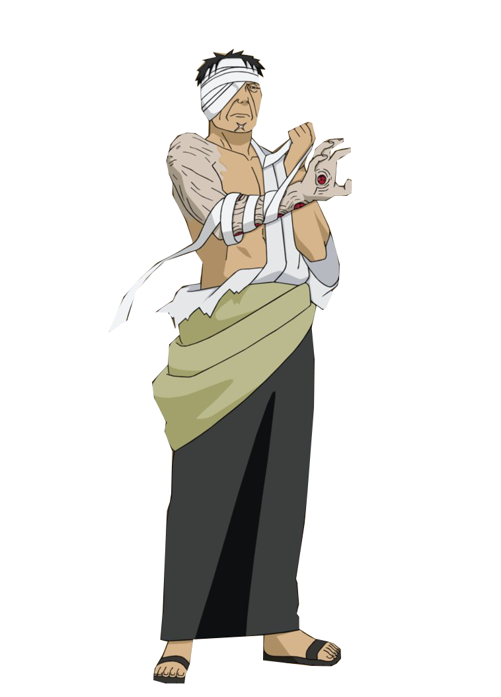
Danzo
An elder of Konohagakure. As the founder and leader of Root, Danzō gained notoriety as The Darkness of the Shinobi because of his frequent unsanctioned actions and his often-suspected (but rarely proven) undermining of specific Konoha personnel. Despite his decades of suspicious deeds, Danzō only ever acted in what he believed were the village's best interests. He was appointed the Sixth Hokage Candidate.
Back to Map

Slide 32
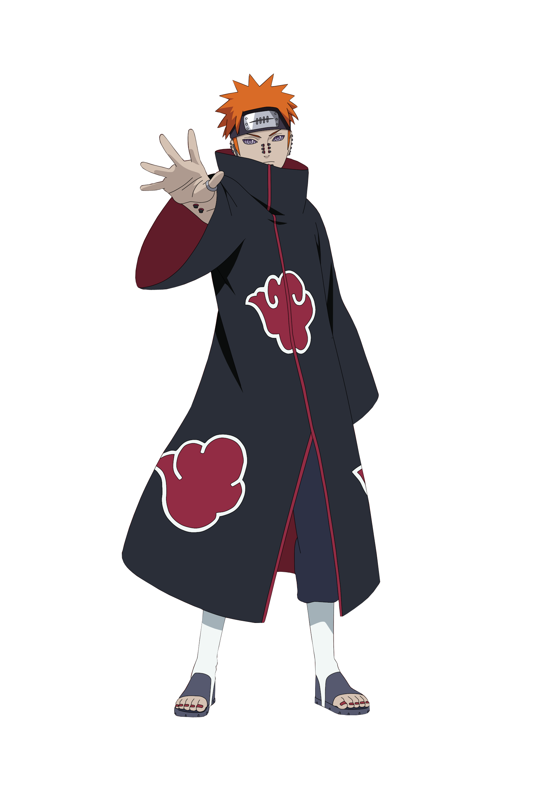
Pain
Pain , along with Konan, began leading a new Akatsuki — one that would force the world into peace using any means necessary.
Back to Map

Slide 33
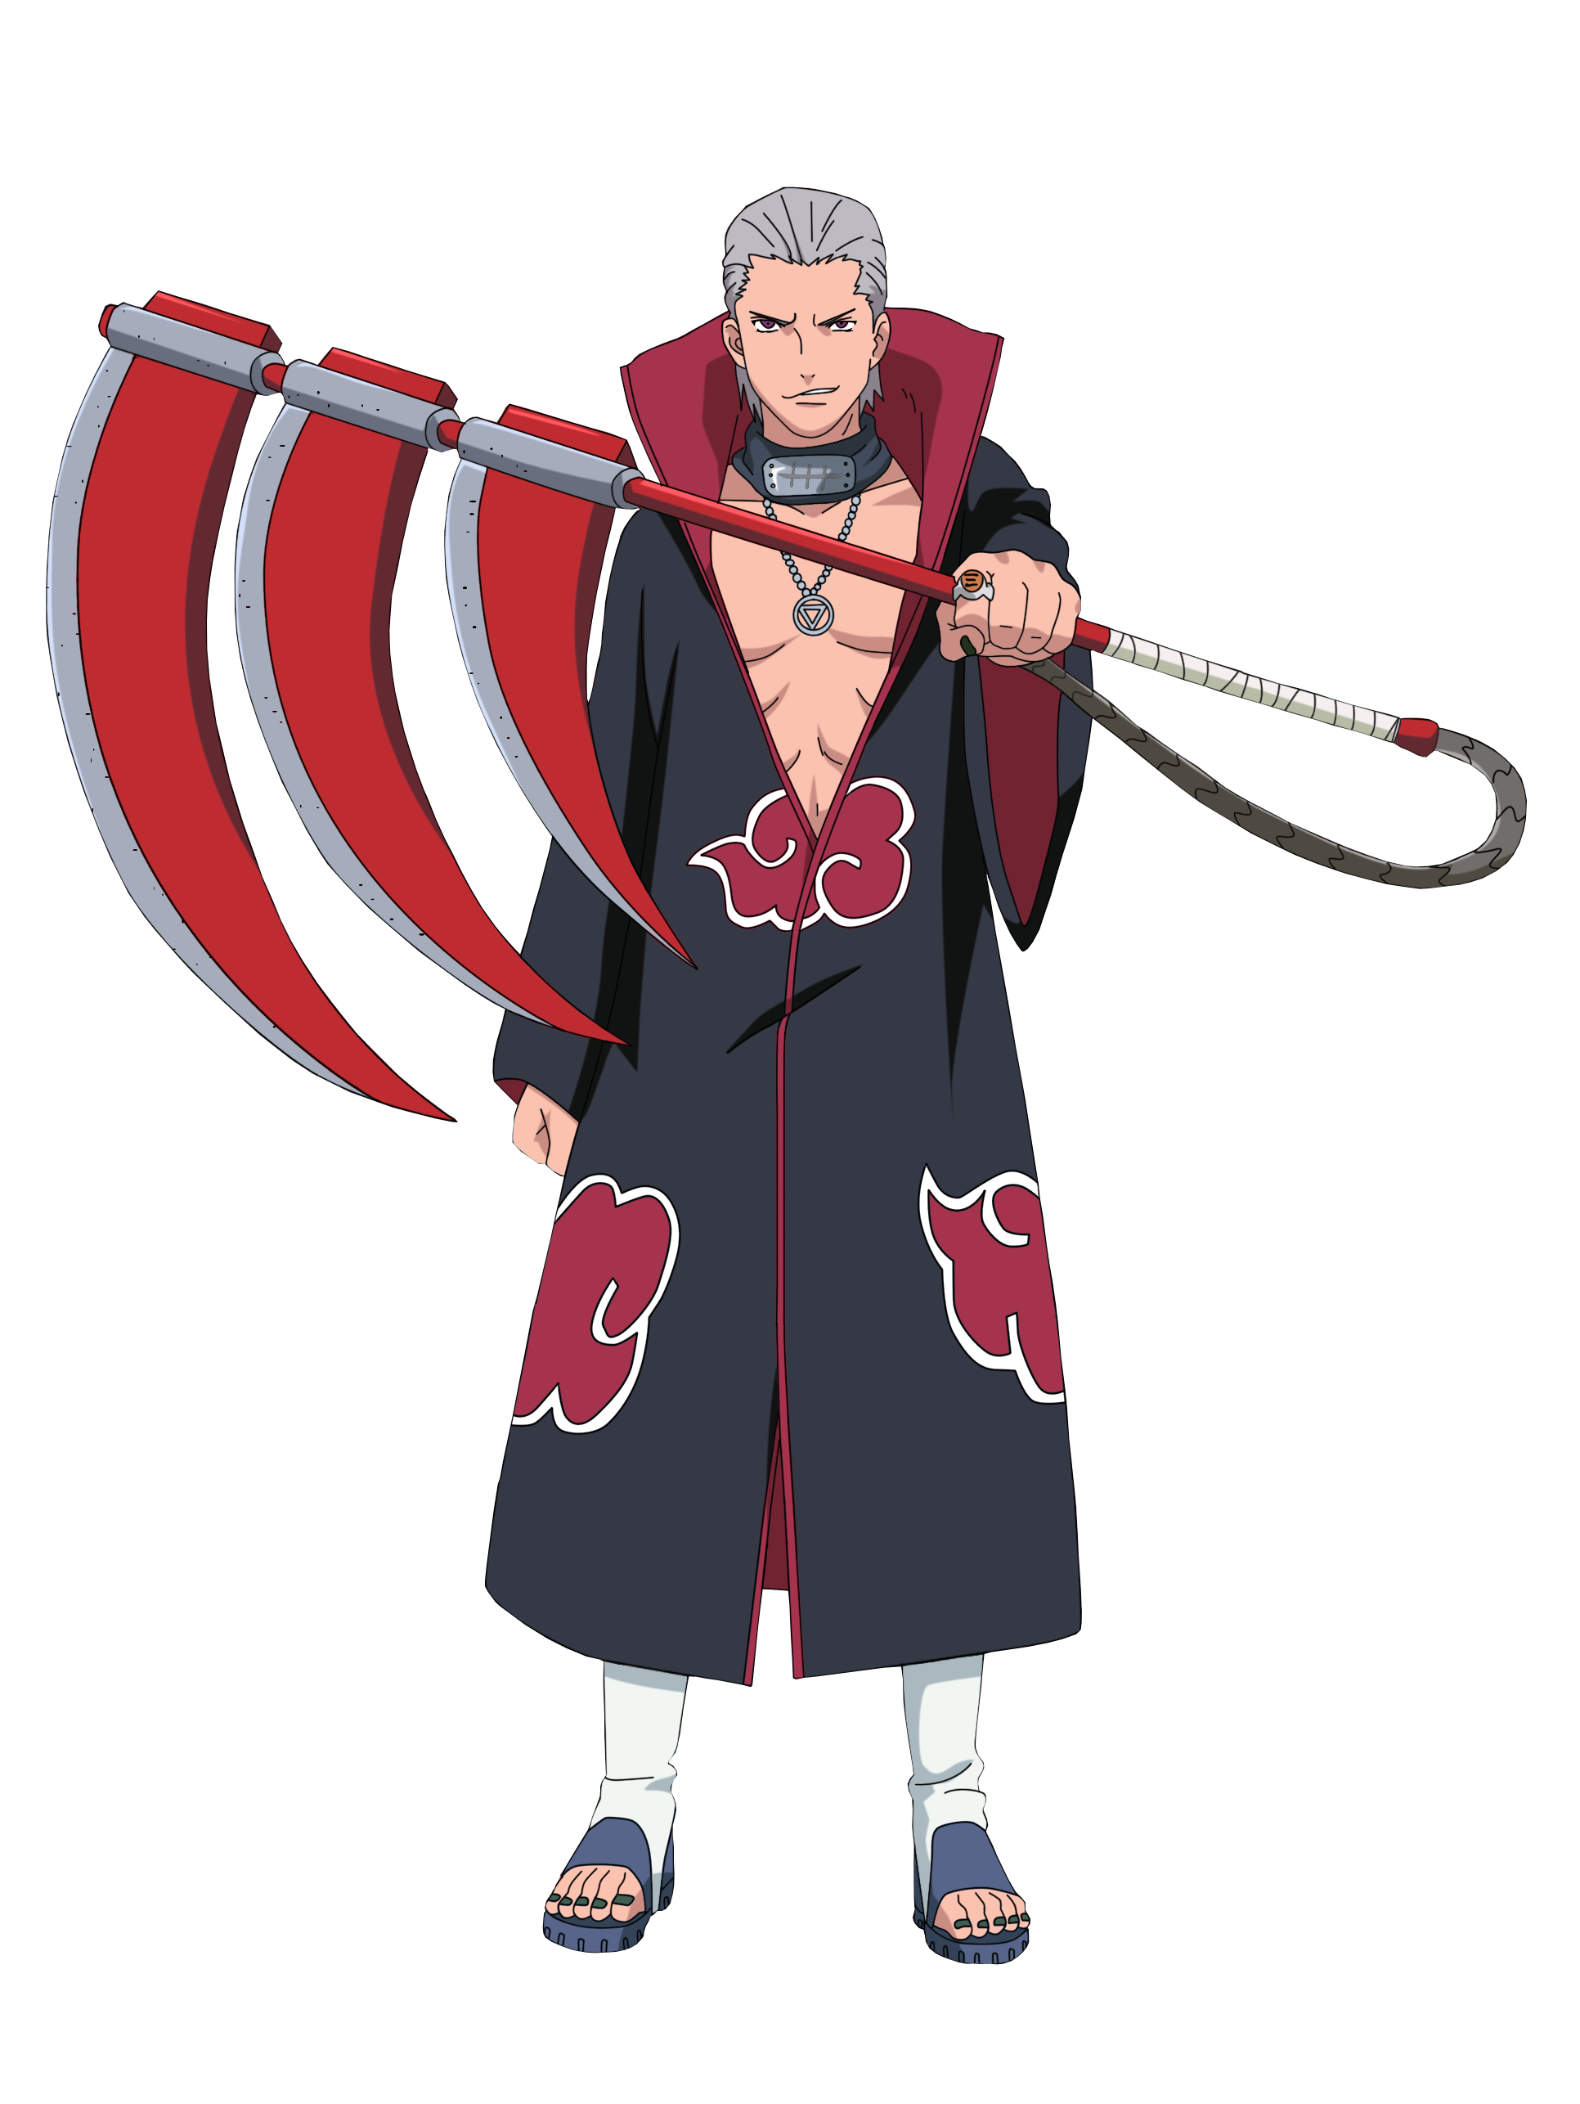
Hidan
An S-rank missing-nin who defected from Yugakure and later joined the Akatsuki. There, he was partnered with Kakuzu, despite the two's somewhat mutual dislike of each other. He was also the second newest member of Akatsuki at the time of Tobi's introduction.
Back to Map

Slide 34
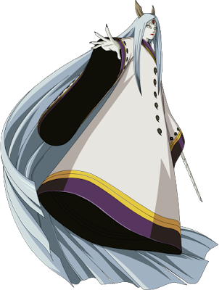
Kaguya
Princess Kaguya Ōtsutsuki is the former matriarch of the Ōtsutsuki clan, the former partner of Isshiki Ōtsutsuki and mother of Hagoromo and Hamura Ōtsutsuki. Long before the founding of the hidden villages, during an era of endless war, Kaguya consumed the fruit of the God Tree and became the first wielder of chakra on Earth, before later merging with the tree to become the Ten-Tails.
Back to Map

Slide 35
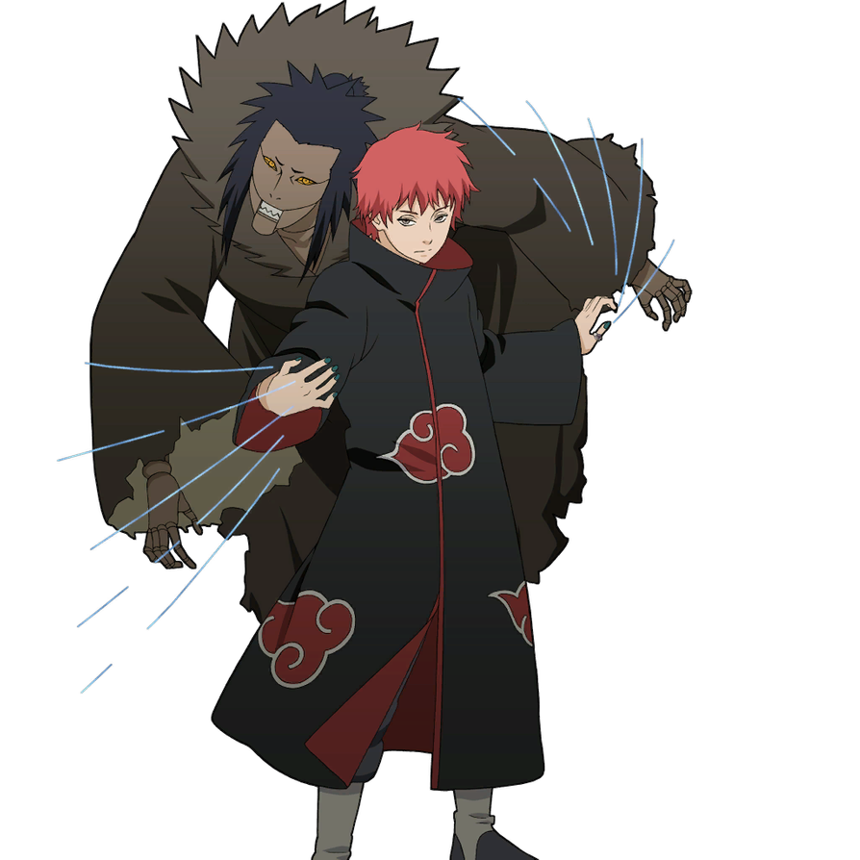
Sasori
Renowned as Sasori of the Red Sand, was an S-rank missing-nin from Sunagakure's Puppet Brigade and a member of Akatsuki, where he was partnered with Orochimaru and later Deidara.
Back to Map

Slide 36
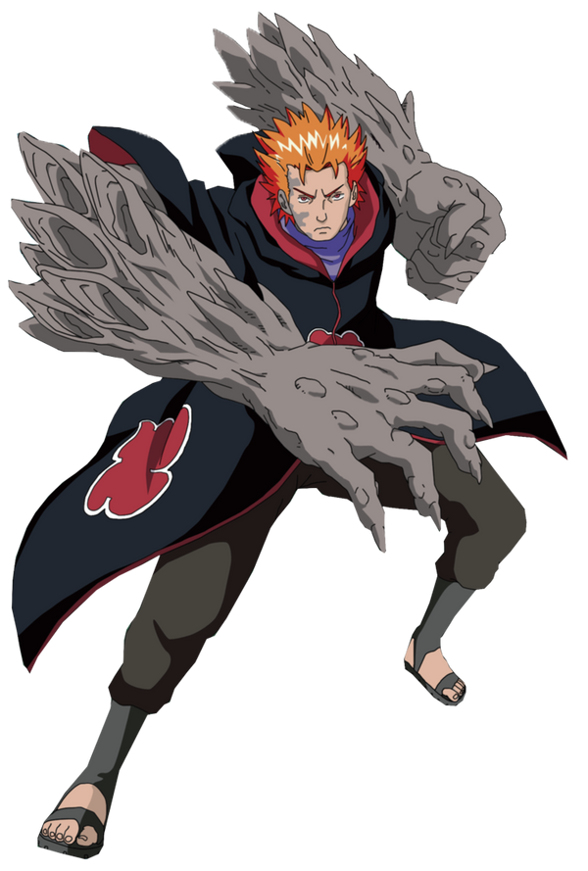
Jugo
A shinobi from an unnamed clan,[4] who was being held at Orochimaru's Northern Hideout. He was said to have gone to Orochimaru of his own free will, hoping that Orochimaru would cure him of his rages. He was later recruited as a member of Sasuke Uchiha's group Taka, which was initially called "Hebi" at the time of its creation.
Back to Map

Slide 37
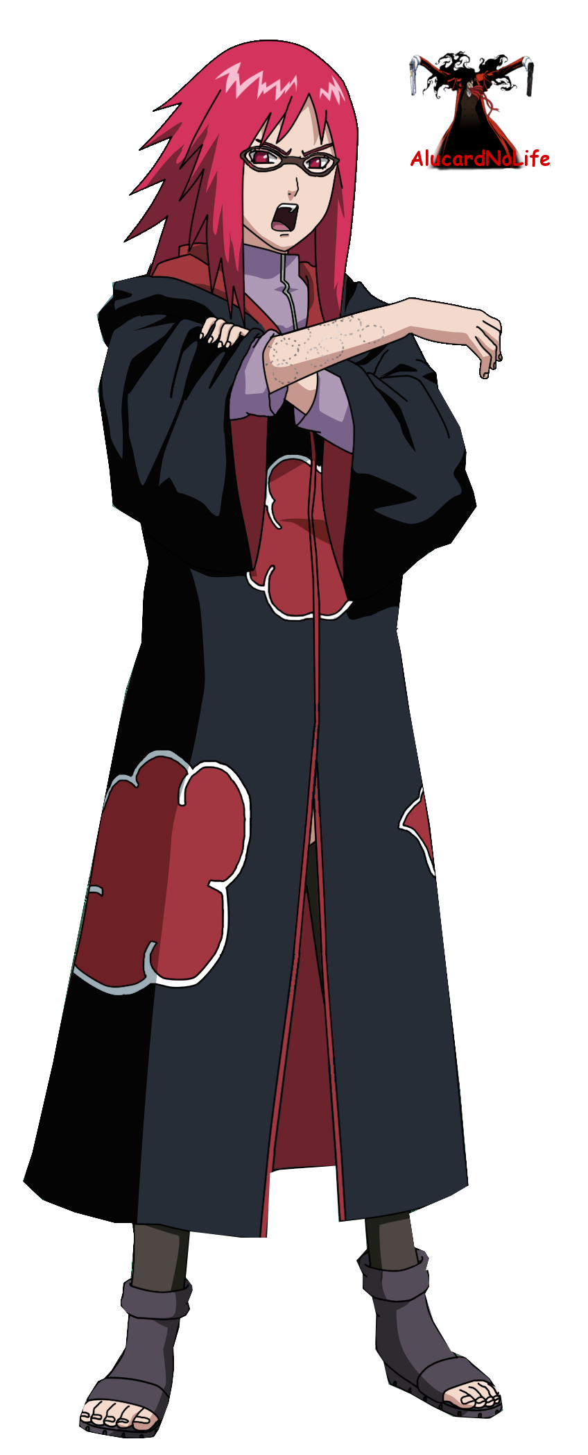
Karin
A subordinate of Orochimaru, a former kunoichi of Kusagakure, and a member of the Uzumaki clan. She assisted Orochimaru in his experiments, and was left in charge as warden of his Southern Hideout while he was away. She was later recruited into Sasuke Uchiha's group Taka, which was initially called "Hebi" at the time of its creation.
Back to Map

Slide 38
Sources
All character descriptions provided by:
https://naruto.fandom.com/wiki/Category:Characters
Map created using:
https://azgaar.github.io/Fantasy-Map-Generator/

